Slide 1

2024 First Quarter Investment Update

Slide 2
Capital Markets Performance Summary (as of December 31, 2023)

Slide 3

Putting the puzzle pieces together
Source: Dall-E, Mill Creek. Prompt: “create a picture of a 70 year old central banker (dressed in a very conservative suit) putting two large puzzle pieces (labeled jobs and inflation) together”

Slide 4
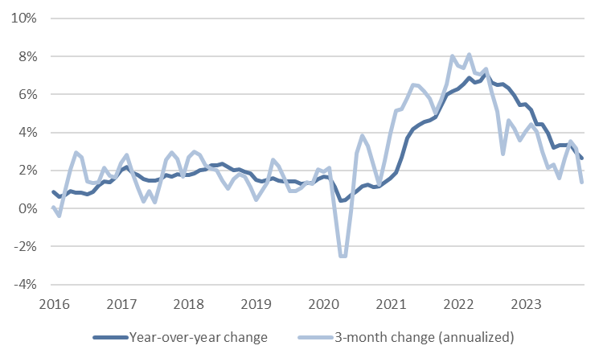
Puzzle piece 1: Inflation is back to target (PCE Price Index)
Source: Bloomberg, Mill Creek.

Slide 5
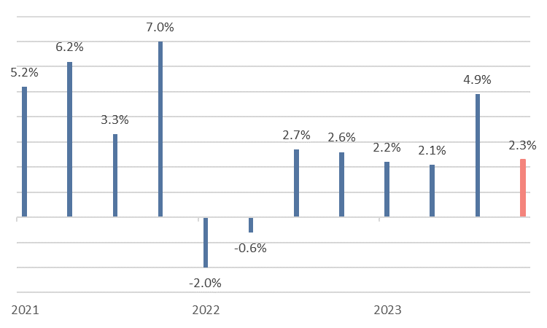
Puzzle piece 2: economic growth slowed without collapsing
Source: Bloomberg, Mill Creek. Chart shows annualized quarter-over-quarter real GDP growth. Salmon bar is real GDP estimate based on the Atlanta Fed’s GDPNow estimate for Q4 2023.

Slide 6
It is time for the Fed to start cutting back to “neutral”
Source: Mill Creek.

Slide 7
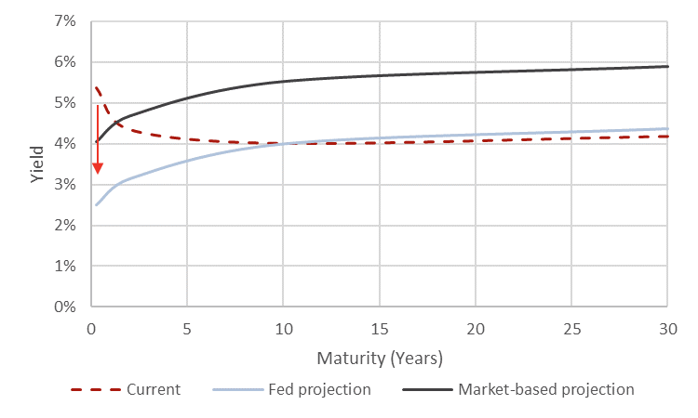
Potential “equilibrium” for the bond market
Source: Bloomberg, Mill Creek.

Slide 8
B
2024 Best Ideas
New issue MBS,
Small cap equities,
Private debt - "non-sponsor-backed, smaller loans ($5–50 million) in sectors experiencing the most blowback from banks retreating from capital markets activity", and
Private equity - health care and industrial services private equity.
Source: Mill Creek 2024 Year Ahead.

Slide 9
Disclosures
This presentation has been prepared by Mill Creek Capital Advisors, LLC (“MCCA”). The information is only intended for its recipients and is not to be forwarded without the consent of MCCA. We believe the information contained in this presentation to be reliable but do not warrant its accuracy or completeness. The opinions, estimates, investment strategies and views expressed in this presentation constitute the judgment of MCCA investment professionals, based on current market conditions and are subject to change without notice. You should not regard it as research or as a research report. Investing involves certain risks and there is no guarantee of profitability; investors may lose all of their investments. You should understand and carefully consider an investment’s objectives, risks, fees, expenses and other information before investing. Diversification and asset allocation does not guarantee a profit and may not protect against market risk. Past performance is not necessarily indicative of future results, and there can be no assurance that any projections or estimates of future performance will be realized.
Forward Looking Statements: Certain of the statements set forth in this presentation constitute “forward-looking statements.” All such forward-looking statements involve risks and uncertainties, and there can be no assurance that the forward-looking statements included in this commentary will prove to be accurate. In light of the significant uncertainties inherent in the forward-looking statements included herein, the inclusion of such information should not be regarded as representations or warranties of MCCA and that the forward-looking statements will be achieved in any specified time frame, if at all.

