Slide 1
Introduction to Investment Migration
2025

Slide 2

About the Firm
60+
Offices worldwide
25+
Years leading the sector
40+
Investment migration options
25,000+
Clients advised
15+
Government advisory mandates
USD 15 billion+
Foreign direct investment raised

Slide 3


We Advise Private Clients and Governments
Private Client Services
Government Advisory Services
  Helping high-net-worth individuals and entrepreneurs to acquire one or more alternative residences and/or citizenships around the world
  Strategic consulting, design, set-up, operation, and promotion of residence and citizenship programs for countries worldwide
  Residence and Citizenship advisory
  Real Estate
  Education
  Concierge
  Residence and Citizenship program design
  Program set-up and operation
  Application processing and due diligence
  Global positioning and promotion
  Over 60 offices worldwide,
  leading the sector for over 25 years
  Raised over USD 15 billion in
  foreign direct investment

Slide 4
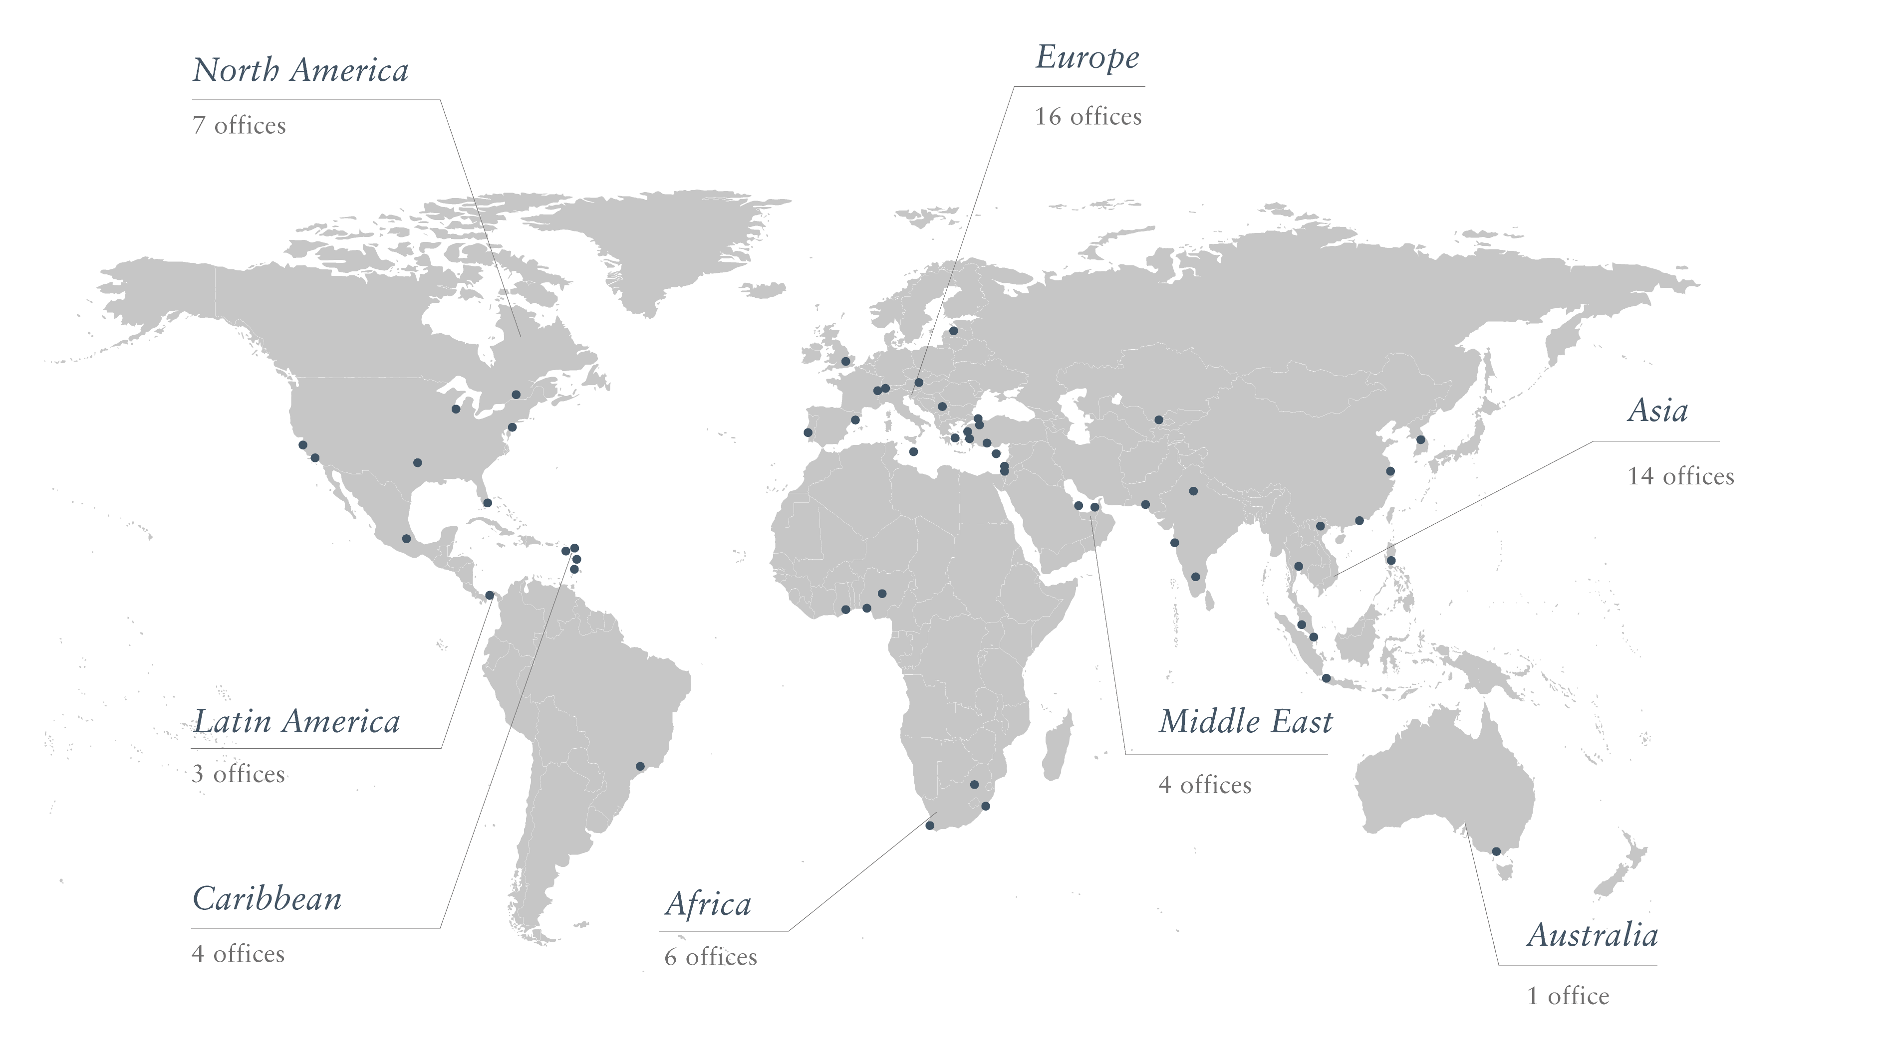
Global Presence

Slide 5
Wealth Planning for High-Net-Worth Clients
Client
Risk Management
Retirement Planning
Super and Pension Structures
Investment Strategy
Cashflow Management
Tax Planning
Trust and Estate Planning
Citizenship and Residence Planning
Notes:
Now more than ever, there’s a strong chance at least one member of the next generation will live in a different country than their parents. If you are part of this conversation from the beginning, you have a much better chance of retaining this generational wealth. Ultimately as a banker, you’re in the service industry covering what is probably the most important thing to many of your clients, their money. As you know, if you’re only speaking to them about investments and returns, there’s nothing from stopping them from going to any other banker who’s offering a better deal. Being a trusted advisor means you’re having deeper and potentially difficult conversations with clients. If you can help them solve a problem they don’t know they even have, then you become the trusted advisor.
Everyone in the wealth management space has the foundation of knowledge to protect and grow a client’s wealth, but those who have the biggest books are able to foster deeper relationships with clients – you differentiate yourself from your competitors by what value you add outside of the banking sphere – think to yourself, as a trusted advisor, how many tools do you have in your tool belt – when you finish speaking about investments, how else can you add value.
When it comes to residency and citizenship planning, the change from when I started in this industry nearly a decade ago until now, is every high net worth individual has at least had a conversation surrounding what we offer or has a friend who has done a program – as a trusted advisor, if you deal with other trusted advisors like Henley & Partners, you will have a multiplying effect on your relationship.

Slide 6
The Differences between Residence and Citizenship
Residence
May grant the right to live, work, travel, and study in a country
Usually comes with conditions or requirements
May give some travel rights
Can be withdrawn
Is likely to affect tax status
Citizenship
Grants full rights, including the right to return to and reside in the country at any time and the right to vote
Can usually be passed on to future generations
Allows international travel
Affords protection from the state
Is lifelong and cannot be withdrawn (except in special circumstances)
Does not affect tax status (except in Eritrea, Kyrgyzstan, and the USA)

Slide 7
Reasons for an Alternative Citizenship or Residence
Visa Waivers and Mobility
Independence and Retirement
Opens travel to countries previously restricted by time-consuming visa application processes
Freedom of movement when some nationals are overly exposed to physical or financial threats
Be able to travel or have the option to relocate at any time
Freedom to retire in a safe country without worrying about changing immigration laws
Privacy and Security
Tax Planning and Expatriation
Increased privacy in banking and improved physical security
Guarantees a secure a truly permanent alternative place to go; the permanent right to reside
Citizenship is one of the tie-breaker rules in most double tax treaties
To renounce citizenship another citizenship must be acquired first

Slide 8
Reasons for an Alternative Citizenship or Residence
Quality of Life
Education
Better quality of life, climate and personal security
Cleaner environment
Better healthcare and transport systems
Graduation at high-ranking schools and language skills are becoming increasingly important as the basis for a successful career
Insurance Policy
Against Geopolitical tensions or emergency situations

Slide 9




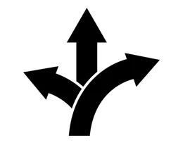

Domicile Diversification
“It’s a case of not putting all your eggs in one basket.”
  Hedging against country-specific risk and global volatility
  Mobility as an alternate asset class
  Building entrepreneurial resilience for your business
  Improving the resilience of portfolios and ensure physical and financial longevity
  Accessing alternative business, career, educational, healthcare, and lifestyle opportunities
  Futureproofing your family by providing them with access to multiple jurisdictions across the globe

Slide 10
Top Client Considerations
“How important is the future expansion of your business into other countries?”
“How much value would be created if you could improve the ease with which you could do business in other countries, and/or travel there?”
“How important is it to have the ability to educate your children abroad?”
“How much more valuable would it be if your children were able to live and work in the same country after they graduate?”
“When you picture your ideal retirement, where do you see that important part of your life taking place?”
“How would you feel if you encountered any restrictions or limitations that could restrict your move to that ideal location?”
“How can you best manage Political, Economic and Environmental risk?”

Slide 11
Private Wealth Migration Trends

Slide 12
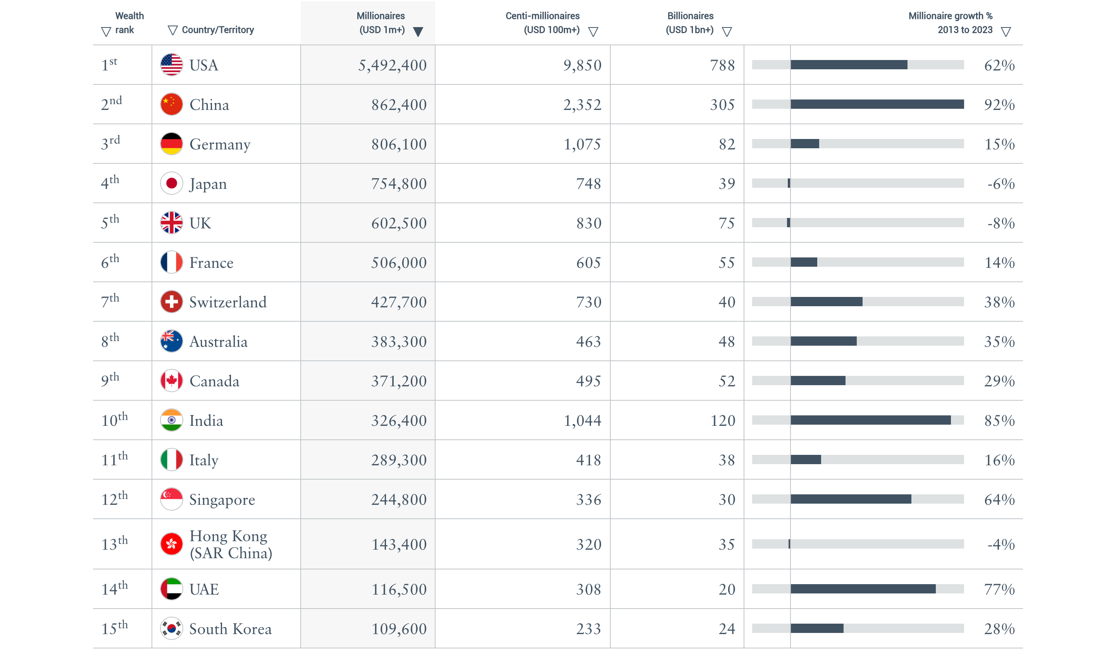
The World’s Top 15 Wealthiest Countries: The W15
Source: Henley Private Wealth Migration Report
Notes:
The table provides wealth data for the world’s Top 15 countries for millionaires, also known as the ‘W15’.
The number of millionaires in the UK has dropped by 8% over the past decade — while soaring elsewhere. In Germany, the HNWI population has increased by 15% over the last 10 years, in France it’s up 14%, while the number has risen by 35% in Australia, 29% in Canada, and an astonishing 62% in the USA. These growth rates are of course a product of several factors including new business formation, local stock market gains and prime property trends in each country, with millionaire migration also being a significant contributing factor.
Figures for December 2023.
Only includes HNWIs living in each country (residents).
HNWI figures rounded to nearest 100.
‘Millionaires’ or ‘HNWIs’ refer to individuals with liquid investable wealth of USD 1 million or more.

Slide 13
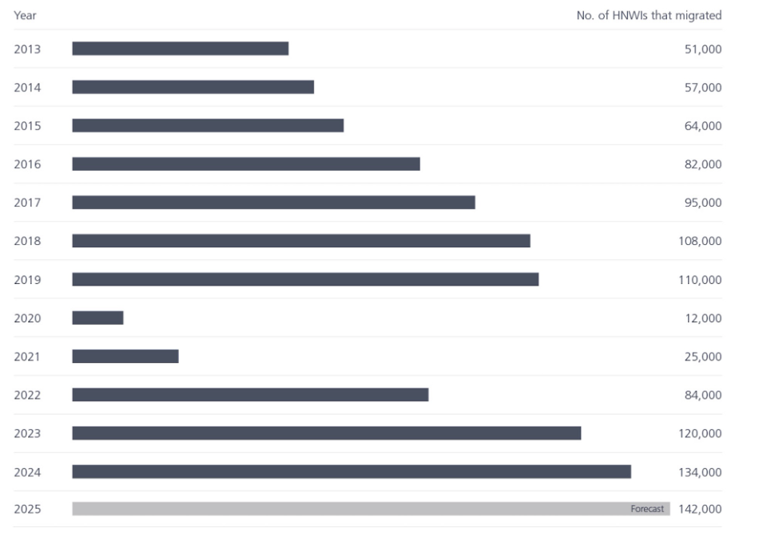
Global Wealth Migration
Source: Henley Private Wealth Migration Report
Notes:
The data reflects the total number of millionaires who have moved to a new country since 2013 — namely, those who have relocated and remained in their new country for longer than six months. There was a steady growth trajectory until 2020 when the Covid-19 pandemic hampered the migration and tracking of millionaires on the move. Recovery commenced rapidly in 2022 with record migration flows recorded in 2023. The 2024 provisional figures and 2025 forecasts indicate continued growth.
This year is shaping up to be a watershed moment in the global migration of wealth. As the world grapples with a perfect storm of geopolitical tensions, economic uncertainty, and social upheaval, millionaires are voting with their feet in record numbers, seeking greener pastures and safer harbors for their assets and family interests. The conflicts in Ukraine and Gaza, far from being isolated and contained battlegrounds, have drawn in major world powers, and are threatening to escalate into broader regional and possibly even global conflagrations. At the same time, growing polarization and fragmentation across many of the world’s nations is eroding social cohesion more generally, fueling a rising sense of unease and anxiety.
An unprecedented 128,000 millionaires are expected to relocate in 2024, eclipsing the previous record of 120,000 set in 2023. To put this in perspective, it's a 16% increase from the 110,000 who moved to a new country in the pre-pandemic days of 2019. This great millionaire migration is a canary in the coal mine, signaling a profound shift in the global landscape and tectonic plates of wealth and power, with far-reaching implications for the future trajectory of the nations they leave behind or those which they make their new home. As these moneyed migrants take flight, they carry with them not just their fortunes, but also their expertise, networks, and dynamism which has a direct impact on the economic vitality of any country.
The 2024 provisional figures are based on year-to-date HNWI movements to June 2024.
Figures rounded to the nearest 1,000.
‘Millionaires’ or ‘HNWIs’ refer to individuals with liquid investable wealth of USD 1 million or more.

Slide 14
Top 10 Nationalities for Enquiries Submitted to Henley & Partners
2018 | 2019 | 2020 | 2021 | 2022 | 2023 | 2024
1. India | 1. India | 1. India | 1. India | 1. USA | India | USA
2. Pakistan | 2. South Africa | 2. USA | 2. USA | 2. India | 2. USA | 2. India
3. South Africa | 3. Bangladesh | 3. Pakistan | 3. South Africa | 3. Nigeria | 3. Pakistan | 3. Pakistan
4. USA | 4. Pakistan | 4. Nigeria | 4. UK | 4. Pakistan | 4. Bangladesh | 4. UK
5. Bangladesh | 5. Nigeria | 5. South Africa | 5. Pakistan | 5. UK | 5. UK | 5. Nigeria
6. UK | 6. USA | 6. UK | 6. Nigeria | 6. Bangladesh | 6. Nigeria | 6. Bangladesh
7. Egypt | 7. UK | 7. Bangladesh | 7. Bangladesh | 7. South Africa | 7. South Africa | 7. South Africa
8. Nigeria | 8. Egypt | 8. Lebanon | 8. Sri Lanka | 8. Canada | 8. Türkiye | 8. Egypt
9. China | 9. Sri Lanka | 9. Iran | 9. Canada | 9. China | 9. Canada | 9. Canada
10. Iran | 10. Lebanon | 10. Egypt | 10. Lebanon | 10. Australia | 10. Nepal | 10. Algeria

Slide 15

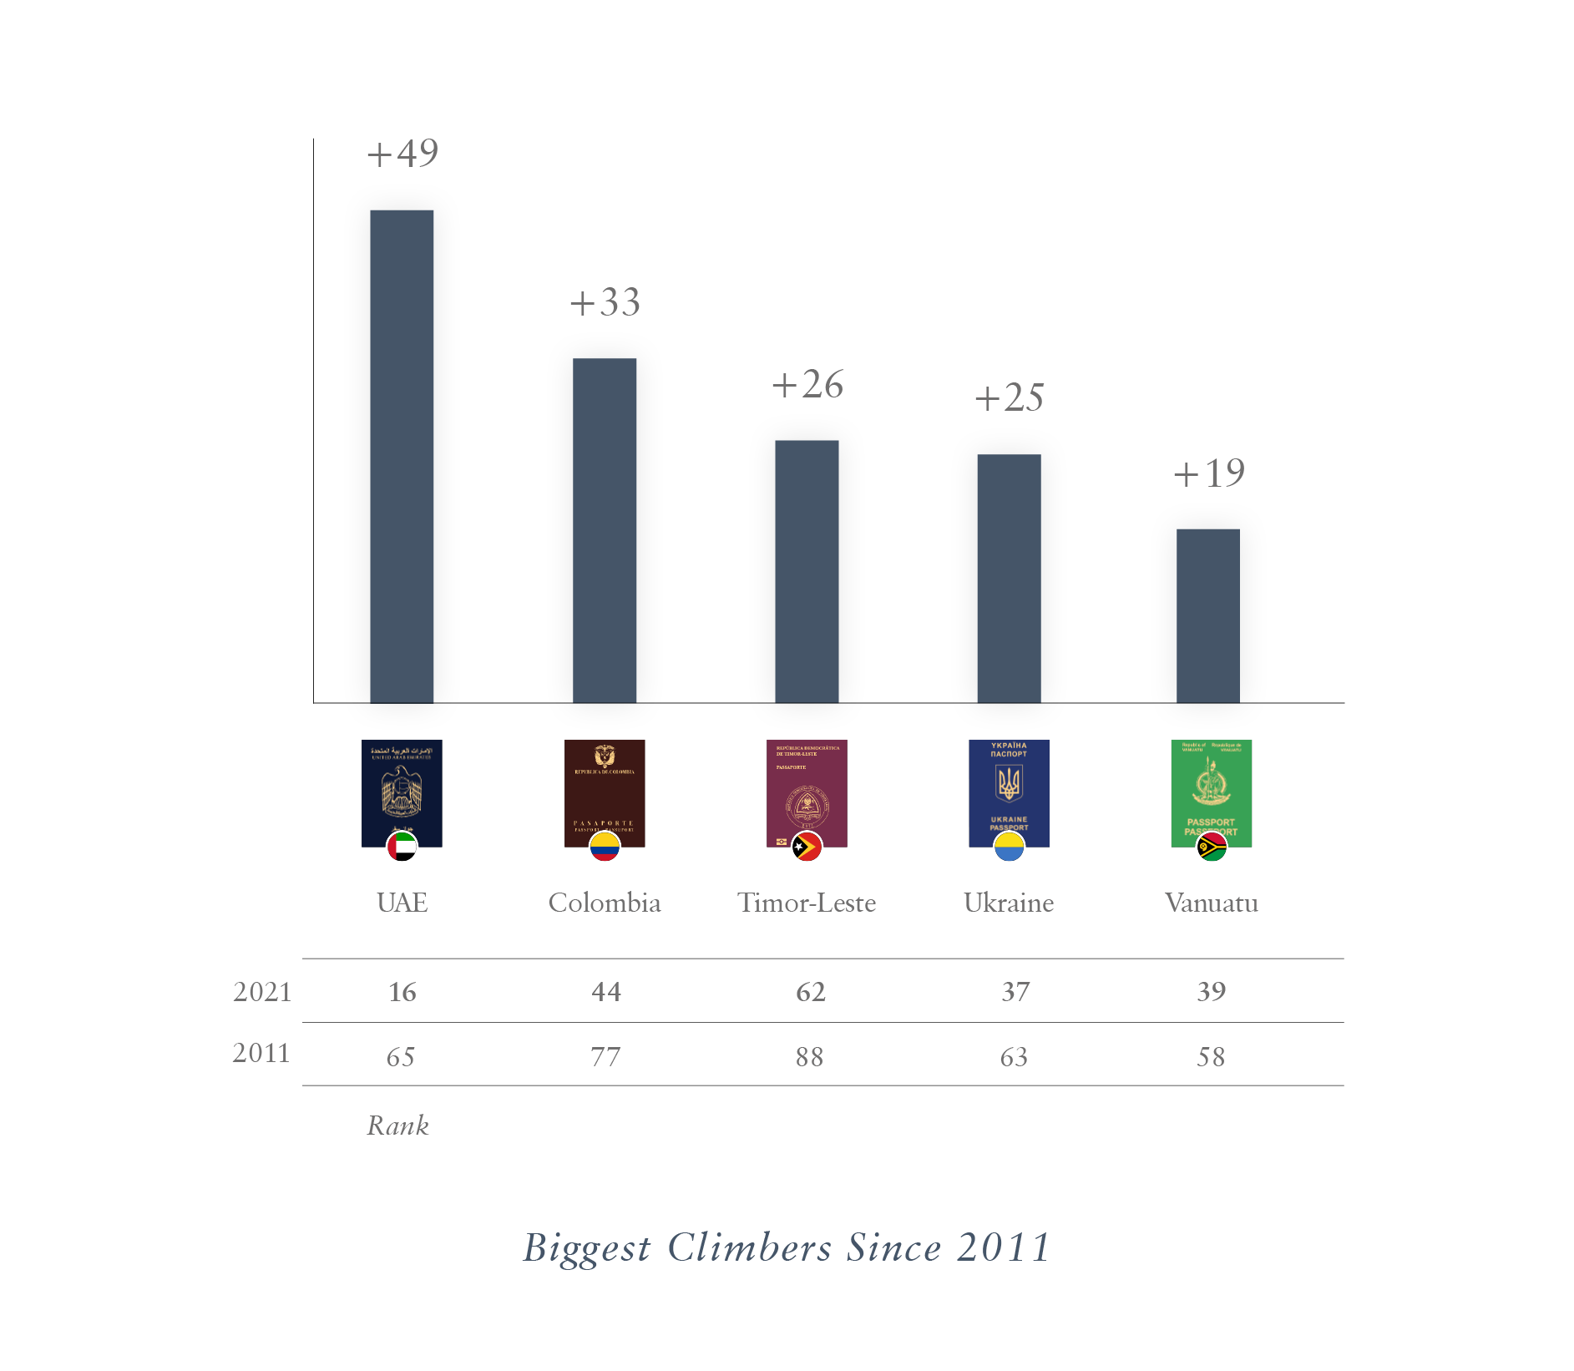

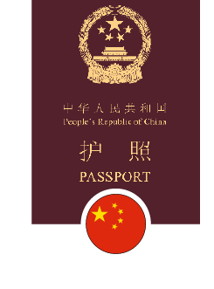






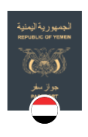
Biggest Climbers and Fallers: 2015–2025
+40
+39
+38
+35
+34
+33
-4
-3
-3
-3
+32
-6
-7
-15
Kosovo
Timor-Leste
Colombia
Georgia
China
Ukraine
UAE
Venezuela
USA
Vanuatu
UK
Canada
Taiwan (Chinese Taipei)
Yemen
2025
63
51
37
44
60
30
10
45
9
54
5
7
33
103
2015
103
90
75
79
94
63
42
30
2
48
1
4
30
100
Rank
Rank
Biggest Climbers Since 2015
Biggest Fallers Since 2015
Disclaimer: The information provided here reflects the Henley Passport Index ranking on 8 January 2025, and in certain instances, coronavirus-related travel bans may take precedence over the visa information recorded here.
Notes:
These two graphs show countries that have climbed highest up the Henley Passport Index rankings over past decade and those that have fallen most sharply
Note: This is a 10-year comparison using January 2025 vs. January 2015 data, based on the figures available in the GMR report

Slide 16

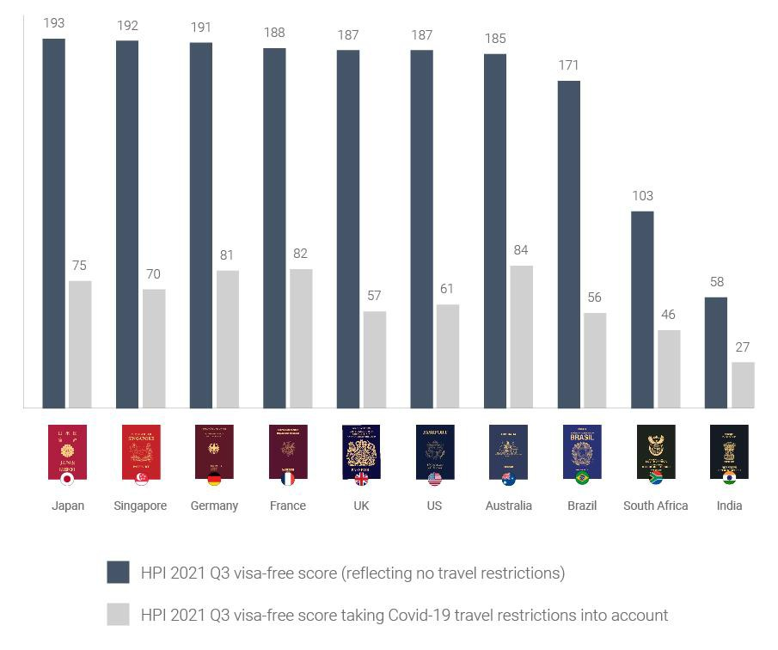
The Impact of Covid-19 on Global Mobility
GLOBAL MOBILITY TODAY

Slide 17
Popular Residence and Citizenship by Investment Programs

Slide 18
European Citizenship Programs
 | Austria | Malta | Turkey
Government processing time: | 24 to 36 months | 18 months | 4 to 6 months
Member of the EU: | Yes | Yes | No
Visa-free access to: | 193 countries | 190 countries | 118 countries
Important visa-free travel destinations: | Canada, Schengen, UK, US, Singapore, Hong Kong | Canada, Schengen, UK, US, Singapore, Hong Kong | Japan, Singapore, Hong Kong, Thailand
Minimum contribution¹: | EUR 3.5 million (contribution) OR EUR 8 million (investment) | EUR 750,000 (contribution) | USD 400,000 (real estate) OR USD 500,000 (fixed deposit)
Must hold period for assets: | N/A | Five years | Three years
Time required in the country: | No physical presence requirement | Two mandatory visits and at least 21 days per 12-month residence period | One visit required and no physical presence requirement
¹ Costs represent the minimum contribution/investment for a single applicant and applicants would incur additional property transaction costs and/or misc. government fees, due diligence fees and processing fees

Slide 19
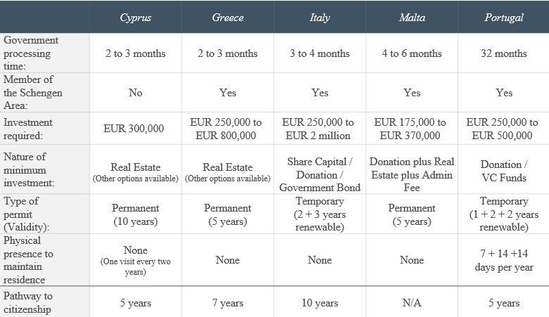
European Residence Programs

Slide 20
Caribbean Citizenship Programs
 | Antigua and Barbuda | Dominica | Grenada | St. Kitts and Nevis | St. Lucia
Government processing time: | 3 to 4 months | 3 to 4 months | 3 to 4 months | 3 to 4 months | 3 to 4 months
Visa-free access to | 150 countries | 142 countries | 146 countries | 155 countries | 146 countries
Important visa-free travel destinations | China, UK, Schengen, Singapore, South Africa, Hong Kong | China, Russia, Schengen, Singapore, Hong Kong | China, Russia, UK, Schengen, Singapore, Hong Kong | UK, Russia, Schengen, Singapore, Hong Kong | UK, Schengen, Singapore, Hong Kong
Minimum real estate purchase¹ | USD 200,000 | USD 200,000 | USD 270,000 + USD 50,000 contrib. | USD 400,000 | USD 300,000
Must hold period for real estate | Five years | Five years | Five years* | Seven years | Five years
Minimum contribution¹ | USD 230,000 | USD 200,000 | USD 235,000 | USD 235,000 | USD 240,000
Physical presence required in the country | Five days within the first five years | None | None | None | None
¹ Cost represents the minimum contribution for a single applicant and would incur additional property transaction costs and/or misc. government fees, due diligence fees and processing fees that differ per program

Slide 21
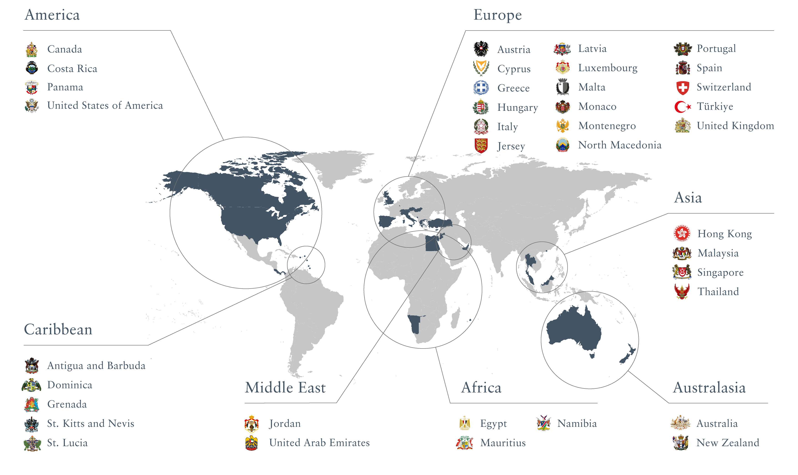
Residence and Citizenship Programs Globally

Slide 22


Contact us
Basil Mohr-Elzeki
Managing Director
Head of Private Clients – Americas
M +1 305-619-7558
E basil.mohr@henleyglobal.com
W henleyglobal.com
Isabel Quintero
Director Private Clients
Miami
M +1 7863667072
E Isabel.quintero@henleyglobal.com
W henleyglobal.com

